Slide 1
Chapter 14
Formatting a Workbook

Slide 2
Learning Objectives
Format text, numbers, dates, and time
Format cells and ranges
Create an Excel table
Highlight cells with conditional formatting
Hide worksheet data
Format a worksheet for printing

Slide 3
Formatting
Formatting is the process of changing a workbook’s appearance by defining the fonts, styles, colors, and decorative features.
Formatting changes only the appearance of data - it does not affect the data itself.
A well-formatted workbook can be easier to read and establish a sense of professionalism.
It can also help draw attention to the points you want to make and provide continuity between the worksheets.
Too little formatting can make the data hard to understand
Too much formatting can overwhelm the data.
Proper formatting is a balance between these two extremes.

Slide 4
Formatting
A well formatted workbook is easier to read and establishes a sense of professionalism with readers.
Do the following to improve the appearance of your workbooks:
  Clearly identify each worksheet’s purpose. You can do this by
    including descriptive column and row titles
    including descriptive labels to identify other important aspects of the worksheet.
    use a descriptive sheet name for each worksheet.
  Don’t crowd a worksheet with too much information. Each worksheet should deal with only one or two topics.

Slide 5
Formatting
Do the following to improve the appearance of your workbooks:
  Place the most important information first in the workbook.
    Position worksheets summarizing your findings near the front of the workbook.
    Position worksheets with detailed and involved analysis near the end as an appendix.
  Use consistent formatting through out the workbook. If negative values appear in red on one worksheet, format them in red on all sheets.

Slide 6
Formatting
Do the following to improve the appearance of your workbooks:
  Pay attention to the formatting of the printed workbook. Make sure your printouts are legible with informative headers and footers.
The goal of formatting is to maintain consistent look throughout a workbook

Slide 7
Formatting Data in Cells
Topics Covered:
  Formatting Text
  Formatting Numbers
  Formatting Dates and Times

Slide 8
Formatting Text
Formatting text involves changing fonts, font sizes, font styles, and color.
The formatting of text is the same process that we used in word.
You can format all of the text in a cell at once or
You select a cell and format individual words with in the cell

Slide 9
Formatting Numbers
The numbers displayed in cells are either values entered directly in cells or values calculated with formulas.
Can be formatted using:
  General number format: default number format, which, for the most part, displays values exactly as they are typed
  Number format: displays values in a way that makes it easy for them to be understood and interpreted

Slide 10
Formatting Numbers
The General number format is good for simple calculations, but some values require additional formatting to make the numbers easier to interpret.
You can format numbers to:
  Set how many digits appear to the right of the decimal point.
  Add commas to act as a thousands separator for large values.
  Include currency or accounting symbols to identify the monetary unit being used.
  Display percentages using the % symbol.

Slide 11
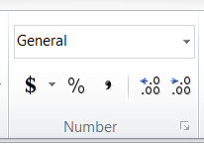
Formatting Numbers
Formatting numbers is done in the Number group on the Home tab.
The Three areas are:
Number Format box
Style Buttons
Number Format Dialog
Box

Slide 12

Style buttons
Allow you to apply a quick style to a cell, range of cells, row or column.
The style buttons are:
Accounting
Number
Format
Percent
Style
Increase
Decrees
Decimal
Place
Comma
Style

Slide 13

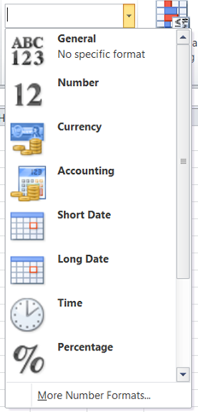
Number Format box
Allow you to apply a quick Format from a list to a cell, range of cells, row or column.
To access the formats click on the down arrow next to the box.
A list will appear with pre-defined styles.

Slide 14

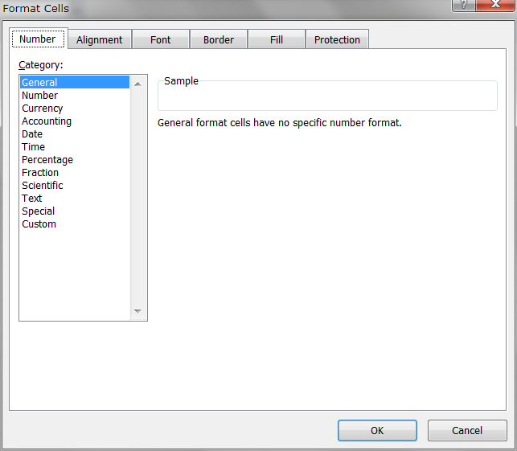
Number Format Dialog box
Allow you to access the advanced setting for formatting numbers
Click on the arrow in the corner of the Number box.
The Format Cells dialog box opens

Slide 15



Formatting Dates and Times
Because Excel stores dates and times as numbers and not as text, you can apply different formats without affecting the date and time value.
Date and time formats are found in the list that appears when the down arrow is clicked in the Quick Format box
The formats are;

Slide 16
Formatting Cells and Ranges
Topics Covered:
  Applying Cell Styles
  Aligning Cell Content
  Indenting Cell Content
  Merging Cells
  Adding Cell Borders
  Changing Cell Background Color
  Using the Format Cells Dialog Box

Slide 17
Applying Cell Styles
A good design practice is to apply the same format to worksheet cells that contain the same type of data.
One way to ensure that you are using consistent formats is to copy and paste the formats using the Format Painter.
The Format Painter is effective, but it can also be time-consuming if you need to copy the same format to several cells scattered across the workbook.
A better way to ensure that cells displaying the same type of data use the same format is with styles

Slide 18
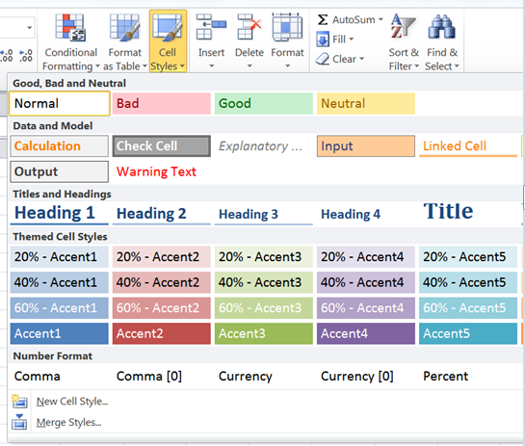
Applying Cell Styles
A style is a selection of formatting options using a specific font and color from the current theme.
Excel has a variety of built-in styles to format worksheet titles, column and row totals, and cells with emphasis.

Slide 19
Working With Themes
Most of the formatting you have applied so far is based on the workbook’s current theme—the default Office theme.
As you have seen, fonts, colors, and cell styles are organized in theme and non-theme categories.
The appearance of these fonts, colors, and cell styles depends on the workbook’s current theme.
If you change the theme, the formatting of these elements also changes throughout the entire workbook.

Slide 20
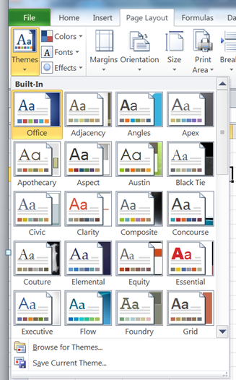
Working With Themes
The Themes button is fount on the Page Layout tab
When you click on the Themes button list of themes appear.

Slide 21
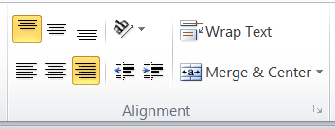
Aligning Cell Content
Unless modified, cell text is aligned with the left and bottom borders of a cell, and cell values are aligned with the right and bottom borders.
Use the Alignment section on the Home tab

Slide 22
Indenting Cell Content
Sometimes you want a cell’s content moved a few spaces from the cell left edge.
To increase click the Increase Indent button.
To decrease or remove an indentation, click the Decrease Indent button.

Slide 23
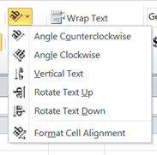
Rotating Cell Content
Text and numbers are usually displayed within cells horizontally.
However, you can rotate cell text to save space or to provide visual interest to a worksheet.
You use the Orientation button in the Alignment category to accomplish this.
When you click on the Orientation button the following list appears.

Slide 24


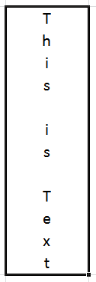
Rotating Cell Content
Angle Counterclockwise - Rotates cell content to a 45 degree angle to the upper-right corner of the merged cell
Angle Clockwise - Rotates cell content to a 45 degree angle to the lower-right corner of the merged cell
Vertical Text - Rotates cell content to appear stacked from the top of the cell to the bottom

Slide 25


Rotating Cell Content
Rotate Text Up - Rotates cell content 90 degrees counterclockwise so that text is placed sideways in the cell and read from the bottom of the cell to the top
Rotate Text Down - Rotates cell content 90 degrees clockwise so that text is placed sideways in the cell and read from the top of the cell to the bottom
After you rotate cell content, you may need to resize the column width or row height to eliminate excess space or add more space so that the cell contents are attractively and completely visible.

Slide 26
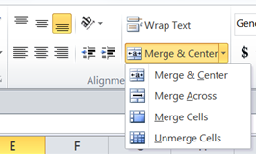
Merging Cells
Merging combines two or more cells into one cell.
You can quickly merge the selected cells and center the content using the Merge button in the Alignment group on the Home tab.
If you click the Merge button arrow, you can choose from the following merge options:

Slide 27

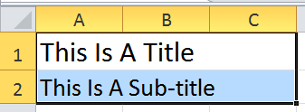
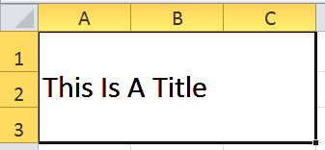
Merging Cells
Merge & Center - Merges the range into one cell and horizontally centers the content
Merge Across - Merges each of the rows in the
selected range across the columns in the range
Merge Cells - Merges the range into a single cell, but does not horizontally center the cell content
Unmerge Cells - Reverses a merge, returning the merged cell back into a range of individual cells

Slide 28
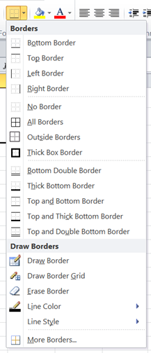
Adding Cell Borders
A border is a line you add along an edge of a cell.
You can add borders to the left, top, right, or bottom of a cell or range; around an entire cell; or around the outside edges of a range.
You can also specify the thickness of and the number of lines in the border.
Border options are available from the Border button in the Font group on the Home tab.

Slide 29
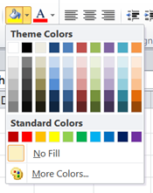
Changing Cell Background Color
You can add background colors, also known as fill colors, to cells using the theme color palette.
If you add a dark fill color to cells, black text can be harder to read than text formatted with a light or white font color
Access the fill colors with the Fill button on the Home tab

Slide 30
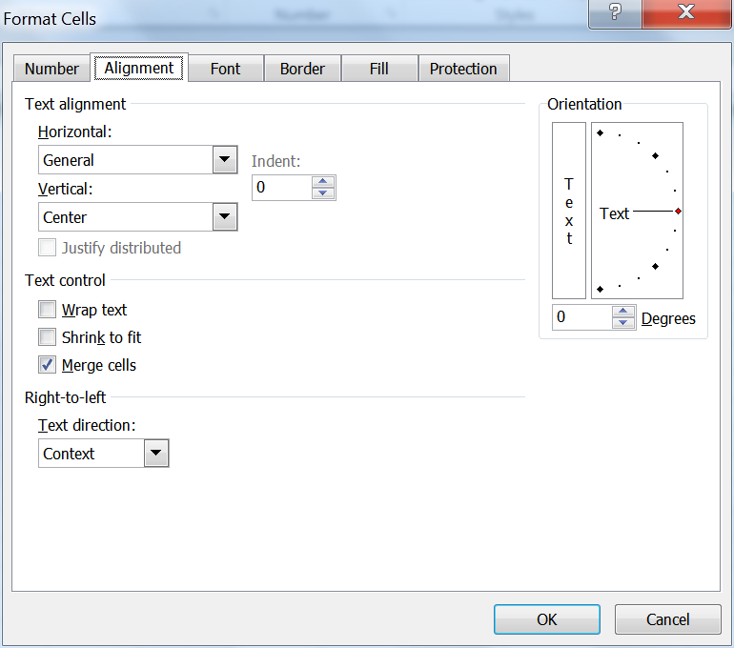
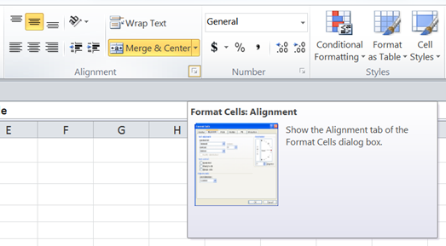
Using the Format Cells Dialog Box
To Access the Format Cell Dialog box click on the arrow in the Alignment group.
The Format Cell Dialog box opens

Slide 31
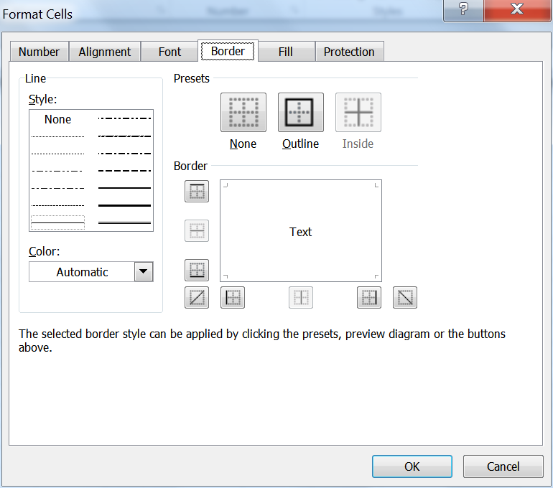
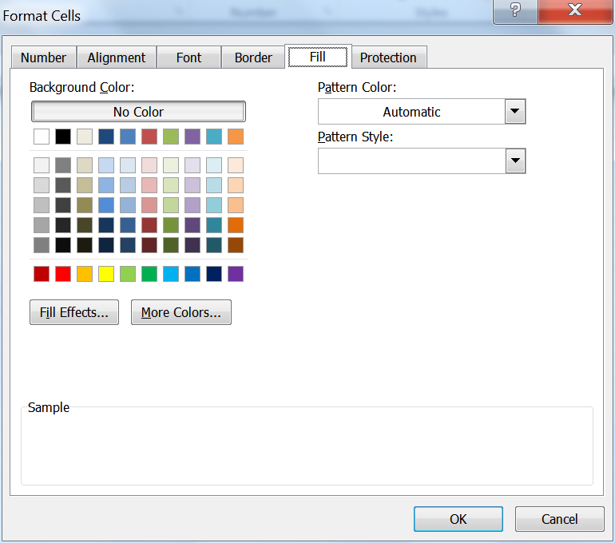
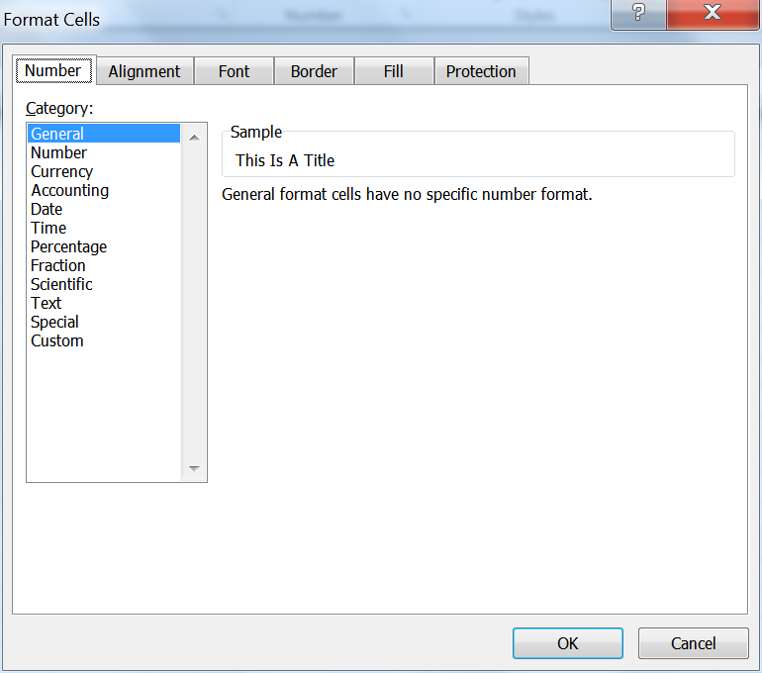

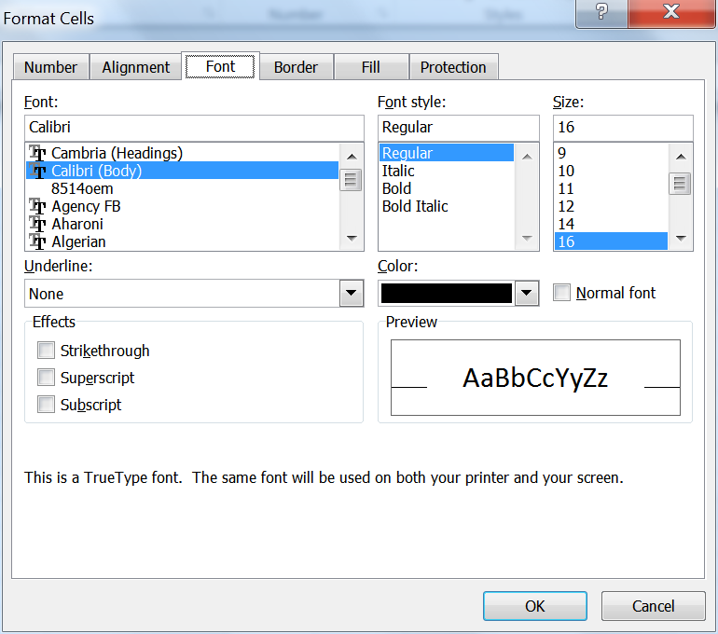
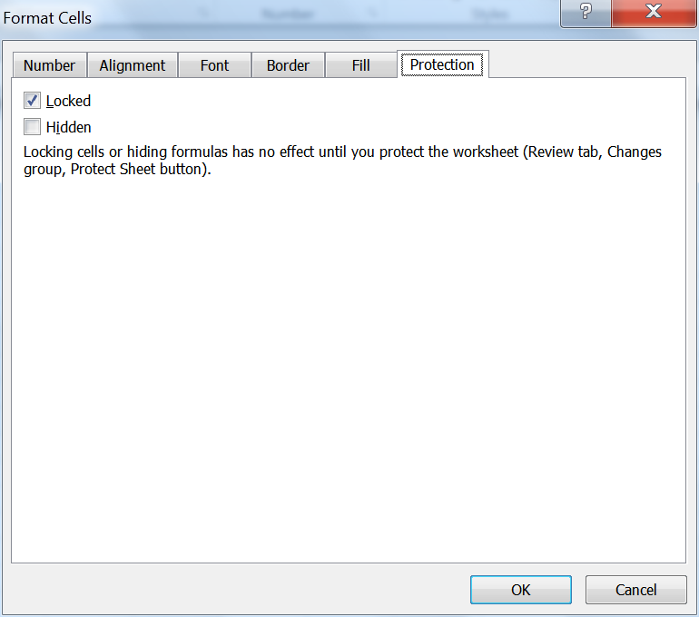
Using the Format Cells Dialog Box
Protection - Provides options for locking or hiding cells to prevent other users from modifying their contents
Number - Provides options for formatting the appearance of
numbers, including dates and numbers treated as text such
as telephone or Social Security numbers
Alignment - Provides options for how data is aligned within a cell
Fill - Provides options for creating and applying background colors and patterns to cells
Border - Provides options for adding and removing cell orders as well as selecting a line style and color
Font - Provides options for selecting font types, sizes, styles, and other formatting attributes such as underlining and font colors

Slide 32
Creating an Excel Table
Topics Covered:
  Using Banded Rows
  Selecting Table Style Options
  Adding Formulas to an Excel Table

Slide 33
Creating an Excel Table
Excel table - A range of data that is treated as a distinct object in a worksheet.
An Excel table makes it easier to identify, manage, and analyze the related data.
In addition, the entire table is formatted using a single table style, a preset style that speciﬁes the formatting for an entire table.
Formatting an entire table with a table style is more efficient than formatting individual cells in the table.
Excel tables can include optional elements such as
  a header row that contains titles for the different columns in the table
  a total row that contains formulas summarizing the values in the table’s data.
You can create more than one Excel table in a worksheet.

Slide 34
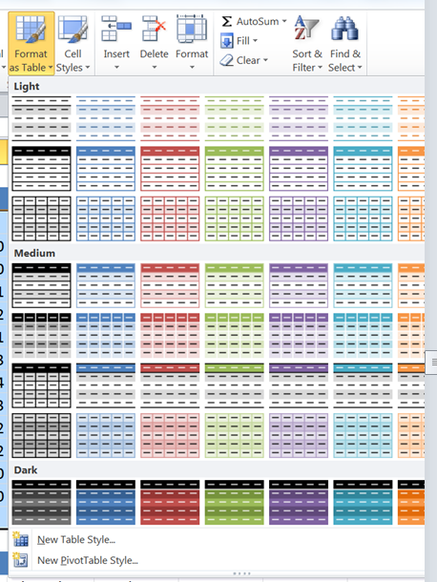
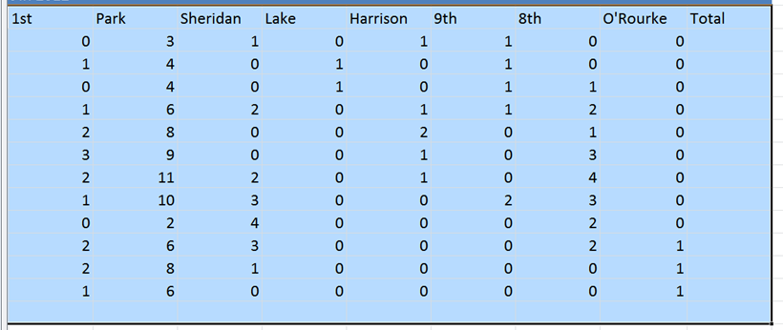
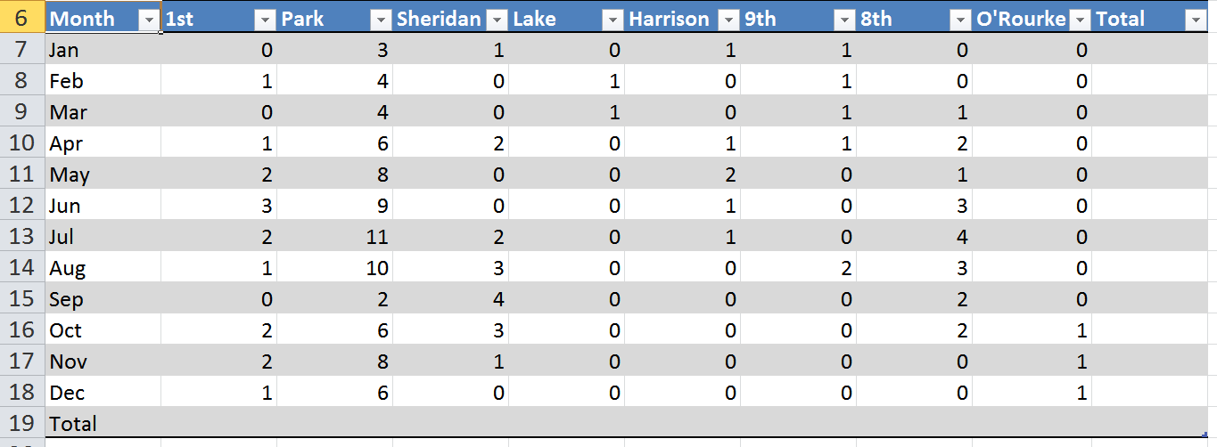
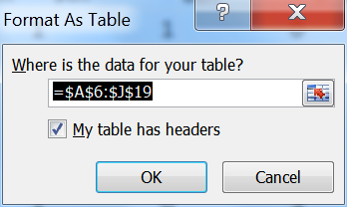
Creating an Excel Table
Start by selecting a range of cells
Select the style for the table by clicking on the Format as table button on the Home tab
The Format As Table Dialog box appears
The table Excel table will be formatted in the style selected.

Slide 35
Using Banded Rows
Banded rows (banded columns): formatting that displays alternate rows (or columns) in an Excel table with different fill colors.
Makes data easier to read, especially in large tables with many rows.

Slide 36
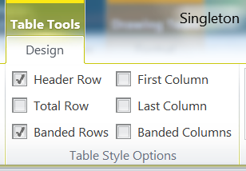
Selecting Table Style Options
After you apply a table style, you can change whether to show or hide the header row, total row, banded rows, and banded columns in the table, as well as whether to format the first column and last column of the table.
These options are available in the Table Style Options group on the Table Tools Design tab and are the same check boxes you saw when you created a table in Word.
You can also use cell styles and the formatting tools you have used with individual cells and ranges to format Excel tables.

Slide 37
Adding Formulas to an Excel Table
When you enter a formula in one cell of an Excel table, the formula is automatically copied to all other cells in that column; this is called a calculated column.
You can also use cell styles and the formatting tools you have used with individual cells and ranges to format Excel tables
When you created a Totals row from the Table Styles Option, you can also quickly enter a summary function for each column in the Total row.
When you click on a cell in the totals row you create an arrow appears next to that cell
If you click on that arrow a list of functions appears that you can apply to that cell.

Slide 38
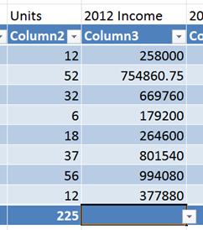
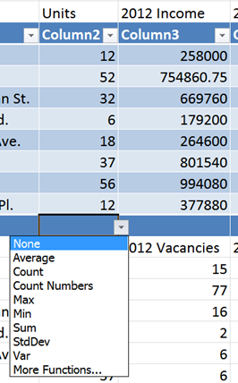
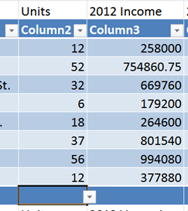
Adding Formulas to an Excel Table

Slide 39
Highlighting Cells with Conditional Formatting
Topics Covered:
  Highlighting a Cell Based on Its Value
  Clearing a Conditional Formatting Rule

Slide 40
Conditional Formatting
Conditional formatting applies formatting only when a cell’s value meets a specified condition. This is often used to help analyze data.
With conditional formatting, the format applied to a cell depends upon the value or content of the cell.
Conditional formatting is dynamic—if the cell’s value changes, the cell’s format also changes as needed.

Slide 41
Conditional Formatting Rules
Each time you apply a conditional format, you are creating a conditional formatting rule.
A rule specifies
  the type of condition (such as formatting cells greater than a specified value),
  the type of formatting when that condition occurs (such as light red fill with dark red (text)
  the cell or range to which the formatting is applied.
You can see all of the conditional formatting rules used in the workbook in the Conditional Formatting Rules Manager dialog box.

Slide 42
Highlighting a Cell Based on Its Value
Cell highlighting changes a cell’s font color or background fill color or both based on the cell’s value.
Page 483 in the book has a list of the Highlight rules.
To highlight cells with conditional formatting:
  first select the range that you want to highlight.
  click the Conditional Formatting button in the Styles group on the Home tab
  point to Highlight Cells Rules or Top/Bottom Rules
  click the type of condition you want to create for the rule.
A dialog box opens so you can specify the formatting to use for that condition.

Slide 43
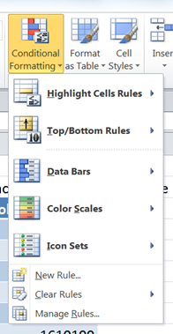
Highlighting a Cell Based on Its Value

Slide 44
Using Conditional Formatting Effectively
Conditional formatting is an excellent way to highlight important trends and data values to clients and colleagues. However, it should be used judiciously.
  Document the conditional formats you use. If a bold, green font means that a sales number is in the top 10 percent of all sales, include that information in a legend in the worksheet. The legend should identify each color used in the worksheet and what it means, so others know why certain cells are highlighted.
  Don’t clutter data with too much highlighting. Limit highlighting rules to one or two per data set.
  Use color sparingly in worksheets with highlights. It is difficult to tell a highlight color from a regular f ll color, especially when fill colors are used in every cell.
  Consider alternatives to conditional formats. If you want to highlight the top 10 sales regions, it might be more effective to simply sort the data with the bestselling regions at the top of the list.

Slide 45
Clearing a Conditional Formatting Rule
If you no longer want to highlight cells using the conditional formatting, you can remove, or clear, the current highlighting rule.

Slide 46
Hiding Worksheet Data
One way to manage the contents of a large worksheet is to selectively hide (and later unhide) rows and columns containing extraneous
information.
This allows you to focus your attention on only a select few data points.
Hiding a row or column does not affect the other formulas in the workbook. Formulas still show the correct value even if they reference a cell in a hidden row or column.

Slide 47
Formatting a Worksheet for Printing
Topics Covered:
  Setting the Print Area
  Inserting and Removing Page Breaks
  Adding Print Titles
  Creating Headers and Footers
  Setting the Page Margins
  Centering Content on a Page

Slide 48
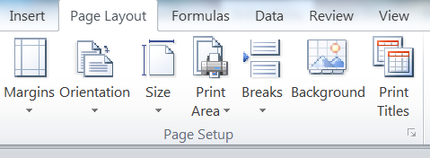
Setting the Print Area
The region that is sent to the printer from the active sheet is known as the print area.
The easiest way to set the print area is on the Page Layout tab in Page Setup group

Slide 49
Inserting and Removing Page Breaks
Often the contents of a worksheet do not fit onto a single page.
Automatic page break: Excel inserts when no more content will fit on the page.
Manual page break: you insert to specify where a page break occurs.
Tip: To remove a manual page break, click the cell below or to the right of the page break, click the Breaks button, and then click Remove Page Break.

Slide 50
Adding Print Titles
A good practice is to include descriptive information such as the company name, logo, and worksheet title on each page of a printout in case a page becomes separated from the other pages.
A print title is information from a workbook that appears on every printed page.

Slide 51
Creating Headers and Footers
Headers and footers contain helpful and descriptive text that is usually not found within the worksheet, such as the workbook’s author, the current date, or the workbook file name.
A header is information that appears in the top margin of each printed page.
A footer is information that is printed in the bottom margin of each printed page.
Include a header or footer with the page number and the total number of pages in a multiple page printout to help ensure you and others have all the pages.
To insert headers and footers go to the Insert tab and click on the Header and Footer button.

Slide 52
Setting the Page Margins
Another way to fit a large worksheet on a single page is to reduce the size of the page margins.

